Slide 1

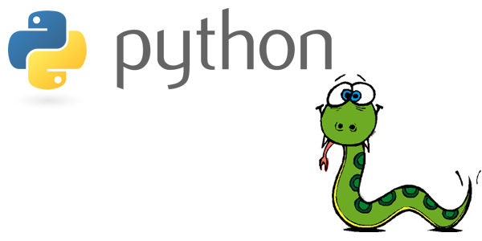
Python interfacing NI VeriStand

Slide 2
Motivation - why Python?
Python is an interpreted, object-oriented, high-level programming language with dynamic semantic. Since its first release in 1991, Python has grown in popularity and it is now used in a wide range of applications
What makes Python such a great programming language are its simplicity and easy-to-learn syntax and readability (some say "it is written in plain English"), all combined with great versatility and capabilities.

Slide 3
Python for .NET
Python for .NET (pythonnet) is a package that gives Python programmers nearly seamless integration with the .NET 4.0+ Common Language Runtime (CLR) on Windows and Mono runtime on Linux and OSX.
Python for .NET provides a powerful application scripting tool for .NET developers. Using this package you can script .NET applications or build entire applications in Python, using .NET services and components written in any language that targets the CLR (C#, VB.NET, F#, C++/CLI).
https://github.com/pythonnet/pythonnet.github.io

Slide 4
2 possible ways to interface VeriStand from Python
Python – Pythonnet – ASAM XIL API – VeriStand gateway
Python – Pythonnet – VeriStand .NET API – VeriStand gateway

Slide 5
Installation
Pythonnet is contained in PyPI
pip install pythonnet

Slide 6
Demos
Running simple Python 3 script to call VeriStand .NET API
Notes:
Run pythonnet installation if it is not installed yet (pip install pythonnet). Computer must be connected to internet
Examples could be run from IDLE 3.6 (32bit) or Visual Studio 2017
Open VeriStandPythonnet_getChannel.py (In IDLE or VS)
Open Engine Demo (c:\Users\Public\Documents\National Instruments\NI VeriStand 2017\Examples\Stimulus Profile\Engine Demo\Engine Demo.nivsproj)
Deploy Engine Demo
Enable Engine Power boolean
Explain VeriStandPythonnet_getChannel.py script
Run VeriStandPythonnet_getChannel.py script
It will read Targets/Controller/Simulation Models/Models/Engine Demo/Outports/RPM value and print it to the screen

Slide 7
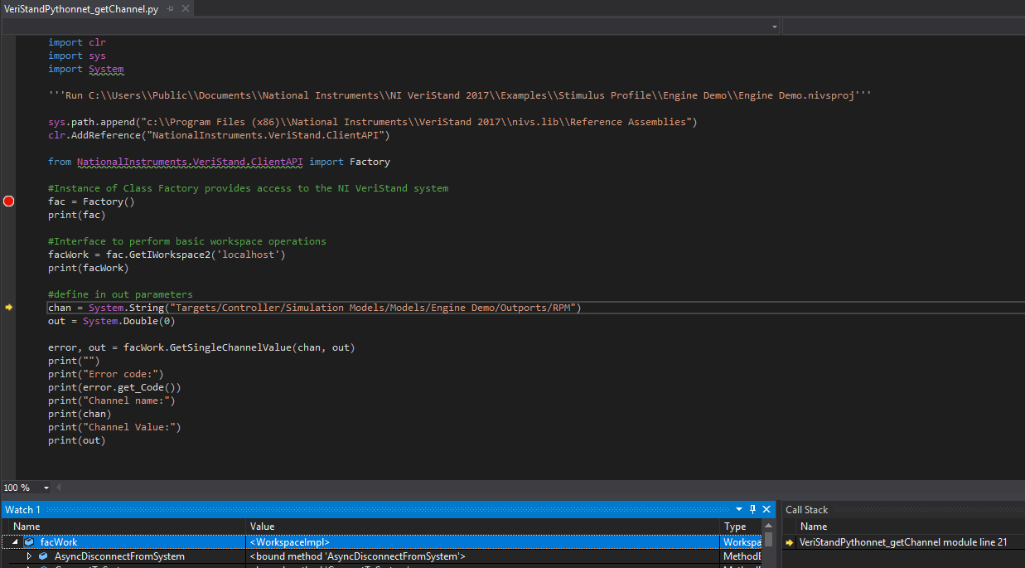
Python calling VeriStand API

Slide 8
Demos
Running simple Python 3 script to call ASAM XIL API
Notes:
Examples could be run from IDLE 3.6 (32bit) or Visual Studio 2017
Copy MAPortConfig.xml to c:\Users\Public\Documents\National Instruments\NI VeriStand 2017\Examples\Stimulus Profile\Engine Demo\
Open VeriStandPythonnetASAMXIL_getChannel.py (In IDLE or VS)
Explain VeriStandPythonnetASAMXIL_getChannel.py script
Run VeriStandPythonnetASAMXIL_getChannel.py script
It will read , write to and read again the Targets/Controller/Simulation Models/Models/Engine Demo/Parameters/b11 parameter

Slide 9
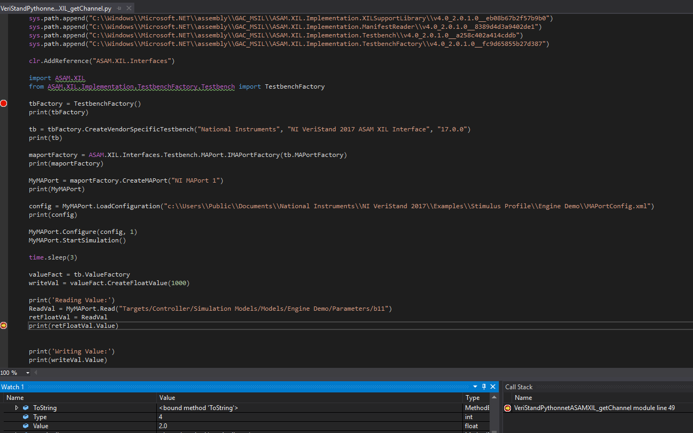
Python calling ASAM XIL API

Slide 10
Running a simple Python example calling ASAM XIL API
Understand the basic steps needed to access VeriStand using an .NET API and ASAM XIL API from Python.
Notes:
Run pythonnet installation if it is not installed yet (pip install pythonnet). Computer must be connected to internet
Examples could be run from IDLE 3.6 (32bit) or Visual Studio 2017
Open VeriStandPythonnet_getChannel.py (In IDLE or VS)
Open Engine Demo (c:\Users\Public\Documents\National Instruments\NI VeriStand 2017\Examples\Stimulus Profile\Engine Demo\Engine Demo.nivsproj)
Deploy Engine Demo
Enable Engine Power boolean
Run VeriStandPythonnet_getChannel.py script
It will read Targets/Controller/Simulation Models/Models/Engine Demo/Outports/RPM value and print it to the screen
Close VeriStand and Python script
Copy MAPortConfig.xml to c:\Users\Public\Documents\National Instruments\NI VeriStand 2017\Examples\Stimulus Profile\Engine Demo\
Open VeriStandPythonnetASAMXIL_getChannel.py (In IDLE or VS)
Explain VeriStandPythonnetASAMXIL_getChannel.py script
Run VeriStandPythonnetASAMXIL_getChannel.py script
It will read , write to and read again the Targets/Controller/Simulation Models/Models/Engine Demo/Parameters/b11 parameter

